Slide 1
Elasticity
From:
Book 1: Chapter 6

Slide 2
Price Elasticity of Demand
Measures buyers’ responsiveness to price changes
Elastic demand
Sensitive to price changes
Large change in quantity
Inelastic demand
Insensitive to price changes
Small change in quantity
LO1

Slide 3
Price Elasticity of Demand Formula
Formula for price elasticity of demand
E_{d} =
Percentage Change in Quantity
Demanded of Product X
Percentage Change in Price
of Product X
LO1

Slide 4
Price Elasticity of Demand Formula
Use the midpoint formula
Ensures consistent results
Change in quantity Change in price
Sum of quantities / 2 Sum of prices / 2
E_{d} =
÷
LO1

Slide 5
Price Elasticity of Demand Formula
Use percentages
Unit free measure
Compare responsiveness across products
Eliminate the minus sign
Easier to compare elasticities
LO1

Slide 6
Interpretation of Elasticity of Demand
E_{d} > 1 demand is elastic
E_{d} = 1 demand is unit elastic
E_{d} < 1 demand is inelastic
Extreme cases
Perfectly inelastic
Perfectly elastic
LO1

Slide 7

Extreme Cases
P
D₁
Perfectly inelastic demand
(Ed = 0)
0
Perfectly inelastic demand
LO1

Slide 8
Extreme Cases
P
D₂
Perfectly elastic
demand
(Ed = ∞)
0
Perfectly elastic demand
LO1

Slide 9
Total Revenue Test
Total Revenue = Price x Quantity
Inelastic demand
P and TR move in the same direction
Elastic demand
P and TR move in opposite directions
LO2

Slide 10
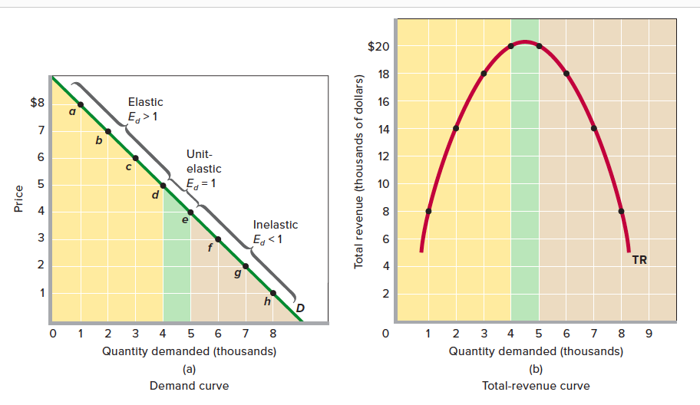
The relation between price elasticity of demand and total revenue.

Slide 11
Summary of Price Elasticity of Demand
Price Elasticity of Demand: A Summary
Absolute Value of Elasticity Coefficient | Demand Is | Description | Impact on Total Revenue of a:
 |  |  | Price Increase | Price Decrease
Greater than 1 (E_{d} > 1) | Elastic or relatively elastic | Q_{d} changes by a larger percentage than does price | Total revenue decreases | Total revenue increases
Equal to 1 (E_{d} = 1) | Unit or unitary elastic | Q_{d} changes by the same percentage as does price | Total revenue is unchanged | Total revenue is unchanged
Less than 1 (E_{d} < 1) | Inelastic or relatively inelastic | Q_{d} changes by a smaller percentage than does price | Total revenue increases | Total revenue decreases
LO2

Slide 12
Determinants of Elasticity of Demand
Substitutability
More substitutes, demand is more elastic
Proportion of Income
Higher proportion of income, demand is more elastic
Luxuries vs. Necessities
Luxury goods, demand is more elastic
Time
More time available, demand is more elastic
LO1

Slide 13
Cross Elasticity of Demand
Measures responsiveness of sales to change in the price of another good
Substitutes – positive sign
Complements – negative sign
Independent goods - zero
Percentage change in quantity demanded of product X
E_{x,y} =
Percentage change in price of product Y
LO4
4-

Slide 14
Income Elasticity of Demand
Measures responsiveness of buyers to changes in income
Normal goods – positive sign
Inferior goods – negative sign
Percentage change
in quantity demanded
E_{i} =
Percentage change in income
LO4

Slide 15
E_{x,y} and E_{i}
Cross and Income Elasticities of Demand
Value of Coefficient | Description | Type of Good(s)
Cross elasticity: Positive (E_{wz} > 0) Negative (E_{xy} < 0) | Quantity demanded of W changes in same direction as change in price of Z Quantity demanded of X changes in opposite direction from change in price of Y | Substitutes Complements
Income elasticity: Positive (E_{i} >0) Negative (E_{i}<0) | Quantity demanded of the product changes in same direction as change in income Quantity demanded of the product changes in opposite direction from change in income | Normal or superior Inferior
LO4

Slide 16
Price Elasticity of Supply
Measures sellers’ responsiveness to price changes
Elastic supply, producers are responsive to price changes
Inelastic supply, producers are not responsive to price changes
LO3

Slide 17
Price Elasticity of Supply
Formula to compute elasticity
E_{s} > 1 supply is elastic
E_{s} < 1 supply is inelastic
Percentage Change in Quantity
Supplied of Product X
E_{s} =
Percentage Change in Price
of Product X
LO3

Slide 18
Impact of Time on Elasticity
The Immediate Market Period
the length of time over which producers are unable to respond to a change in price with a change in quantity supplied.
The Short Run
a period of time too short to change plant capacity but long enough to use the fixed-sized plant more or less intensively.
The Long Run
a time period long enough for firms to adjust their plant sizes and for new firms to enter (or existing firms to leave) the industry.

Slide 19
Reading Assignment
“Elasticity and Pricing Power: Why Different Consumers Pay Different Prices”
Book 1 Page 134-135

